Slide 1
Transit Delay Time prediction using Time Series Transformers
Pravesh Koirala

Slide 2
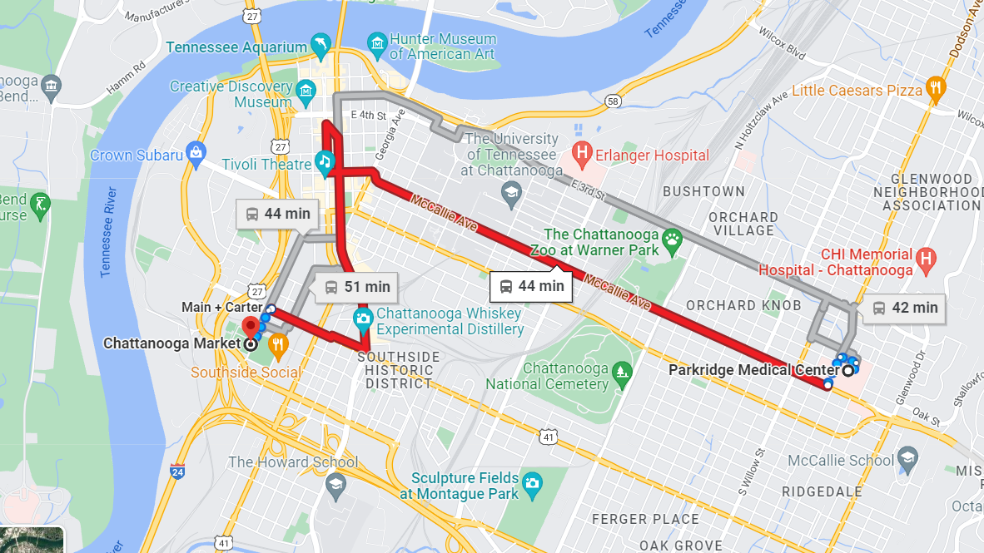

Slide 3


Slide 4
Problem Statement
Predict the delay in the Fixed-line Transit System.
Predictors?
Weather (temperature, humidity, precipitation)
Day of the week.
Time of the day.
School breaks / holidays / Concerts or Events.
Nature of the route.
Downtown vs Suburb.

Slide 5
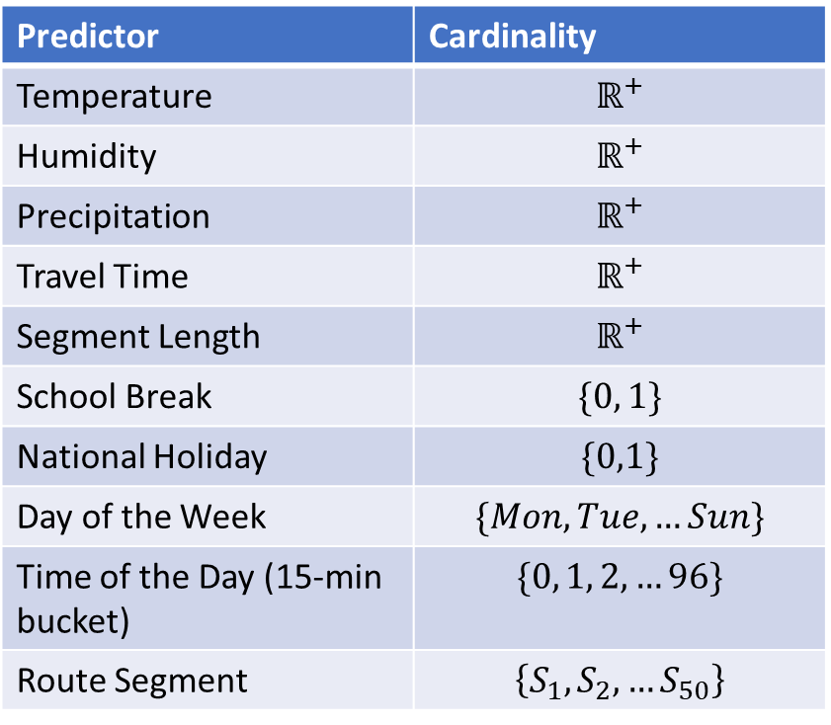
Challenges
Predictor | Cardinality
Temperature | $$ℝ^{+}$$
Humidity | $$ℝ^{+}$$
Precipitation | $$ℝ^{+}$$
Travel Time | $$ℝ^{+}$$
Segment Length | $$ℝ^{+}$$
School Break | $$\{0, 1\}$$
National Holiday | $$\{0,1\}$$
Day of the Week | $$\{Mon, Tue, …Sun\}$$
Time of the Day (15-min bucket) | $$\{0, 1, 2, …96\}$$
Route Segment | $$\left\{S_{1}, S_{2}, …S_{50}\right\}$$
Nature of Predictors:
*There are more than 3000 route segments in the dataset, we only consider a few for the purpose of simplification

Slide 6
DataSet
Courtesy CARTA
APC (Automated Passenger Count) Data.
2022 Jan-April
Preprocessing:
Scaling (Linear, Logarithmic)
Time Bucketing of 15 mins.
Filtering on segments to keep it small.

Slide 7
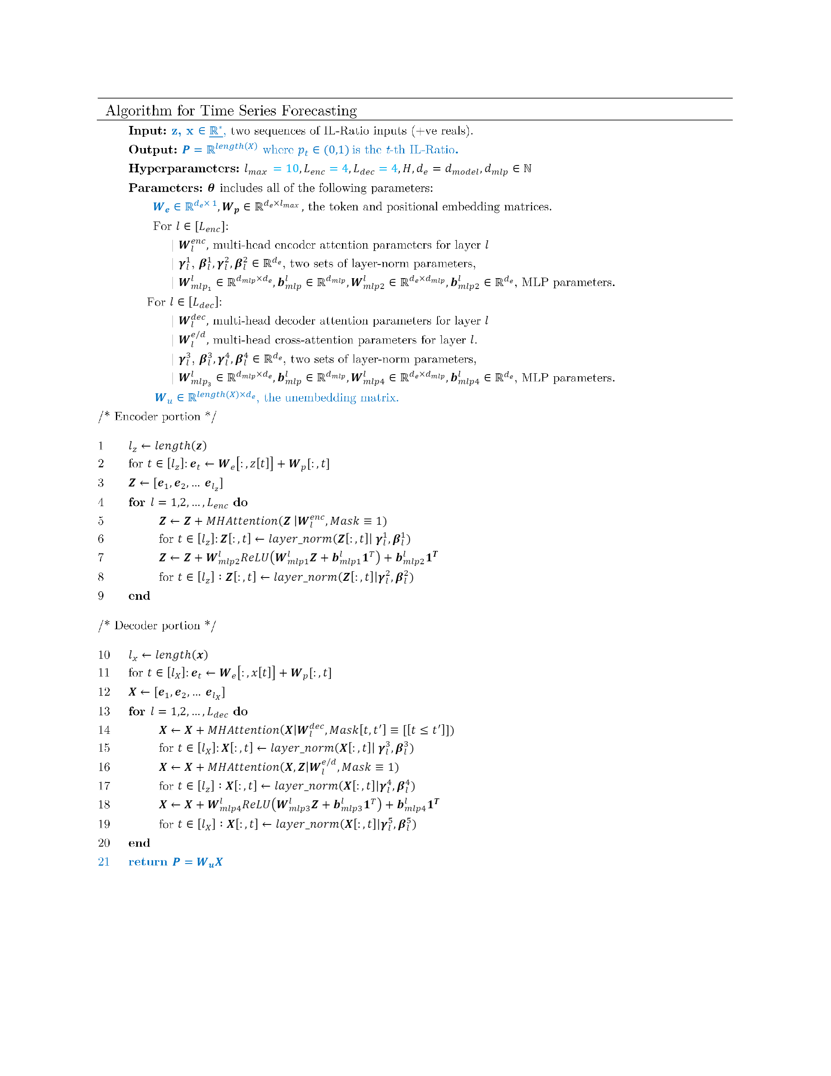
Time Series Transformer
An extension of the *traditional* transformer that allows you to work with continuous time predictors.
Check https://github.com/PraveshKoirala/Transformers-Paper for an overview on the method.
EXTENSION:
Change the architecture in such a way that it now works with both Categorical and Continuous predictors.

Slide 8
Embedding
Time Series Transformer Encoder
Categorical vars
Continuous vars
Time Series Transformer Decoder
Time Series data points
Time Series prediction points
Fig: Architecture of Mixed Time Series Transformer

Slide 9
Critical Analysis
Why not go with pure decoder architecture since it’s just a next item prediction task?
Answer: Sticked with tried and tested model. Could potentially look into using a decoder only architecture.
Bigger question on the inherent assumption i.e. “Delay of a segment is dependent upon past environment and past delays of the segment.”
But realistically, delay also largely depends upon the past traffic conditions of ALL the other connected route segments. How do you encode that?

Slide 10


T=0
T=2
T=1
T=3
Fig: Delay propagation in Traffic Networks

Slide 11
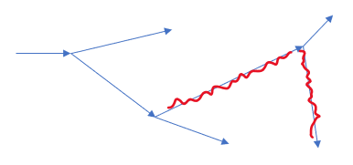
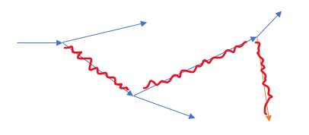
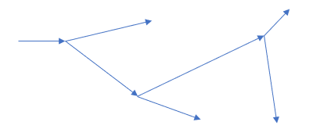
Embedding
Time Series Transformer Encoder
Categorical vars
Continuous vars
Time Series graph embeddings
Time Series Transformer Decoder
Delay prediction
Fig: Architecture of Mixed Time Series Transformer

Slide 12

How do you incorporate the information of the global structure in Transformers?
Generate Embedding using Graph Neural Networks?
Predict $ℝ^{n}$ in decoder instead of a single $ℝ?$
Hoping that decoder self-attention will figure out a way to associate segment delays across time?

